Slide 1
CS 622 Advanced Machine Learning
Dr. Waseem Shahzad
Professor
Department of Computer Science

Slide 2
Reading Materials
Recommended Supplementary Texts:
Ian H. Witten & Eibe Frank, Data Mining: Practical Machine Learning Tools and Techniques with Java Implementations, Morgan Kaufmann, 2013.
T. Hastie, R. Tibshirani, & J. H. Friedman, The Elements of Statistical Learning : Data Mining, Inference, and Prediction Springer Verlag, 2001.
Richard O. Duda, Peter E. Hart, & David G. Stork, Pattern Classification Wiley-Interscience, 2000.
P. Langley, Elements of Machine Learning, Morgan Kaufman Publishers, San Fancisco, CA, 1995.
S. M. Weiss & C. A. Kulikowski, Computer Systems that Learn, Morgan Kaufman Publishers, San Fancisco, CA, 1991.
J. W. Shavlik & T. G. Dietterich (Eds.), Readings in Machine Learning, Morgan Kaufman Publishers, San Fancisco, CA, 1990.

Slide 3
Evaluation
Grading
Project 15
Student Presentations 5
Assignments + Quiz 10
Sessional Exams (2) 30
Final Exam 40
------------
100

Slide 4
Why “Learn” ?
Machine learning is programming computers to optimize a performance criterion using example data or past experience.
There is no need to “learn” to calculate payroll
Learning is used when:
Human expertise does not exist (navigating on Mars),
Humans are unable to explain their expertise (speech recognition)
Solution changes in time (routing on a computer network)
Solution needs to be adapted to particular cases (user biometrics)

Slide 5
What We Talk About When We Talk About“Learning”
Learning general models from a data of particular examples
Data is cheap and abundant (data warehouses, data marts); knowledge is expensive and scarce.
Example in retail: Customer transactions to consumer behavior:
People who bought “Blink” also bought “Outliers” (www.amazon.com)
Build a model that is a good and useful approximation to the data.

Slide 6
What is machine learning
Making the computers perform the intelligent tasks you performed is Artificial Intelligence
Learning to perform these tasks using existing data is called Machine Learning
In short, Machine Learning is learning from DATA

Slide 7
What is Machine Learning?
Optimize a performance criterion using example data or past experience.
Role of Statistics: Inference from a sample
Role of Computer science: Efficient algorithms to
Solve the optimization problem
Representing and evaluating the model for inference

Slide 8
Machine Learning
Retail: Market basket analysis, Customer relationship management (CRM)
Finance: Credit scoring, fraud detection
Manufacturing: Control, robotics, troubleshooting
Medicine: Medical diagnosis
Telecommunications: Spam filters, intrusion detection
Bioinformatics: Motifs, alignment
Web mining: Search engines
...

Slide 9
Applications
Association
Supervised Learning
Classification
Regression
Unsupervised Learning
Reinforcement Learning

Slide 10
Learning Associations
Basket analysis:
P (Y | X ) probability that somebody who buys X also buys Y where X and Y are products/services.
Example: P ( chips | carbonated_drink ) = 0.7

Slide 11
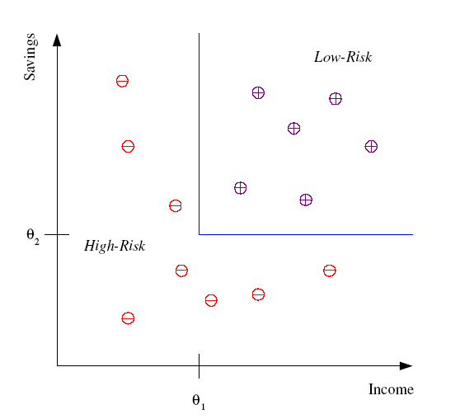
Classification
Example: Credit scoring
Differentiating between low-risk and high-risk customers from their income and savings
Discriminant: IF income > θ₁ AND savings > θ₂
THEN low-risk ELSE high-risk

Slide 12
Classification: Applications
Aka Pattern recognition
Face recognition: Pose, lighting, occlusion (glasses, beard), make-up, hair style
Character recognition: Different handwriting styles.
Speech recognition: Temporal dependency.
Medical diagnosis: From symptoms to illnesses
Biometrics: Recognition/authentication using physical and/or behavioral characteristics: Face, iris, signature, etc
...

Slide 13








Face Recognition
Training examples of a person
Test images
ORL dataset,
AT&T Laboratories, Cambridge UK

Slide 14
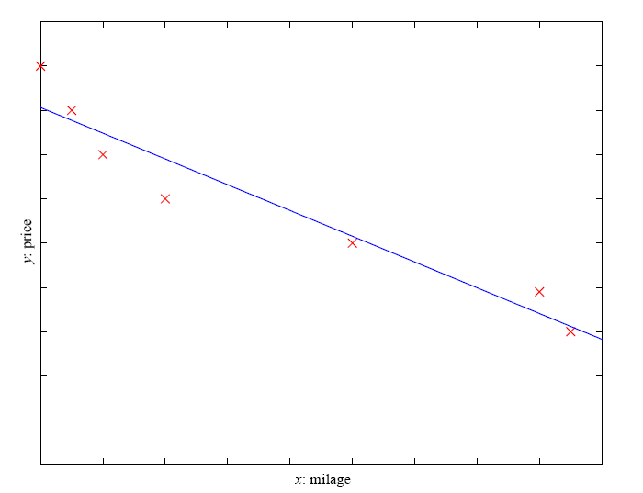
Regression
Example: Price of a used car
x : car attributes
y : price
y = g (x | θ )
g ( ) model,
θ parameters
y = wx+w₀

Slide 15
Supervised Learning: Uses
Prediction of future cases:
Forecasting: Predicting stock prices, weather conditions, or sales trends.
Healthcare: Predicting patient outcomes, such as disease progression or treatment effectiveness.
Customer Behavior: Anticipating churn, purchase likelihood, or lifetime value of a customer.
Supply Chain: Predicting demand to optimize inventory levels.
Financial Services: Risk assessment for loan approvals or credit scoring.
Knowledge extraction:
Decision Support: Generating rules or patterns that help doctors, lawyers, or analysts make decisions (e.g., identifying symptoms linked to a disease).
Business Intelligence: Uncovering actionable insights from customer reviews, feedback, or sales data.
Education: Understanding factors contributing to student success or dropout rates.
Agriculture: Identifying optimal farming practices based on weather, soil, and crop yield data.

Slide 16
Supervised Learning: Uses
Compression:
Data Simplification: Creating summary representations of large datasets, such as dimensionality reduction with techniques like PCA or t-SNE.
Image and Video Compression: Using machine learning to compress multimedia content while retaining quality.
Model Simplification: Building simpler models that encapsulate complex datasets for easier interpretation.
Natural Language Processing (NLP): Summarizing large text datasets or documents into concise representations.
Outlier detection
Fraud Detection: Identifying fraudulent transactions in banking, e-commerce, or insurance claims.
Anomaly Detection: Spotting unusual patterns in manufacturing processes, like equipment failures.
Cybersecurity: Detecting network intrusions or malicious activity.
Public Health: Identifying unusual outbreaks or rare disease cases in epidemiology.

Slide 17
Unsupervised Learning
Learning “what normally happens”
No output
Clustering: Grouping similar instances
Example applications
Customer segmentation in CRM
Image compression: Color quantization
Bioinformatics: Learning motifs

Slide 18
Reinforcement Learning
Learning a policy: A sequence of outputs
No supervised output but delayed reward
Credit assignment problem
Game playing
Robot in a maze
Multiple agents, partial observability, ...

Slide 19
Resources: Datasets
UCI Repository: http://www.ics.uci.edu/~mlearn/MLRepository.html
UCI KDD Archive: http://kdd.ics.uci.edu/summary.data.application.html
Statlib: http://lib.stat.cmu.edu/
Delve: http://www.cs.utoronto.ca/~delve/

Slide 20
Resources: Journals
Journal of Machine Learning Research www.jmlr.org
Machine Learning
Neural Computation
Neural Networks
IEEE Transactions on Neural Networks
IEEE Transactions on Pattern Analysis and Machine Intelligence
Annals of Statistics
Journal of the American Statistical Association
...

Slide 21
Resources: Conferences
International Conference on Machine Learning (ICML)
European Conference on Machine Learning (ECML)
Neural Information Processing Systems (NIPS)
Uncertainty in Artificial Intelligence (UAI)
Computational Learning Theory (COLT)
International Conference on Artificial Neural Networks (ICANN)
International Conference on AI & Statistics (AISTATS)
International Conference on Pattern Recognition (ICPR)
...

Slide 22
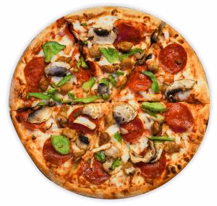
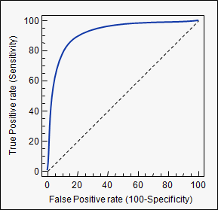
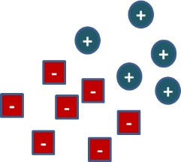
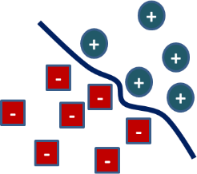
A typical machine learning system
Data collection and feature extraction
Identify a Problem
Model Training
Evaluation
Deployment
Webserver
Software Package

